Slide 1
Model-based Integrated Planning and Control of Autonomous Vehicles using Artificial Potential Fields with uncertain environment
Emilio Benenati
Josyula Viswanath Das
26th November 2021

Slide 2


Potential 1: Potential 2:

Slide 3
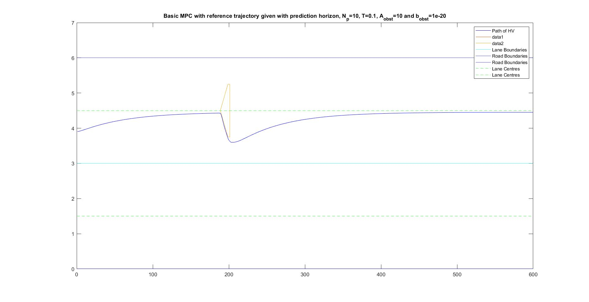
Vehicle Trajectory with Potential 1 as the APF (with distance of the triangular point from the centre of the obstacle = 2.5m )

Slide 4
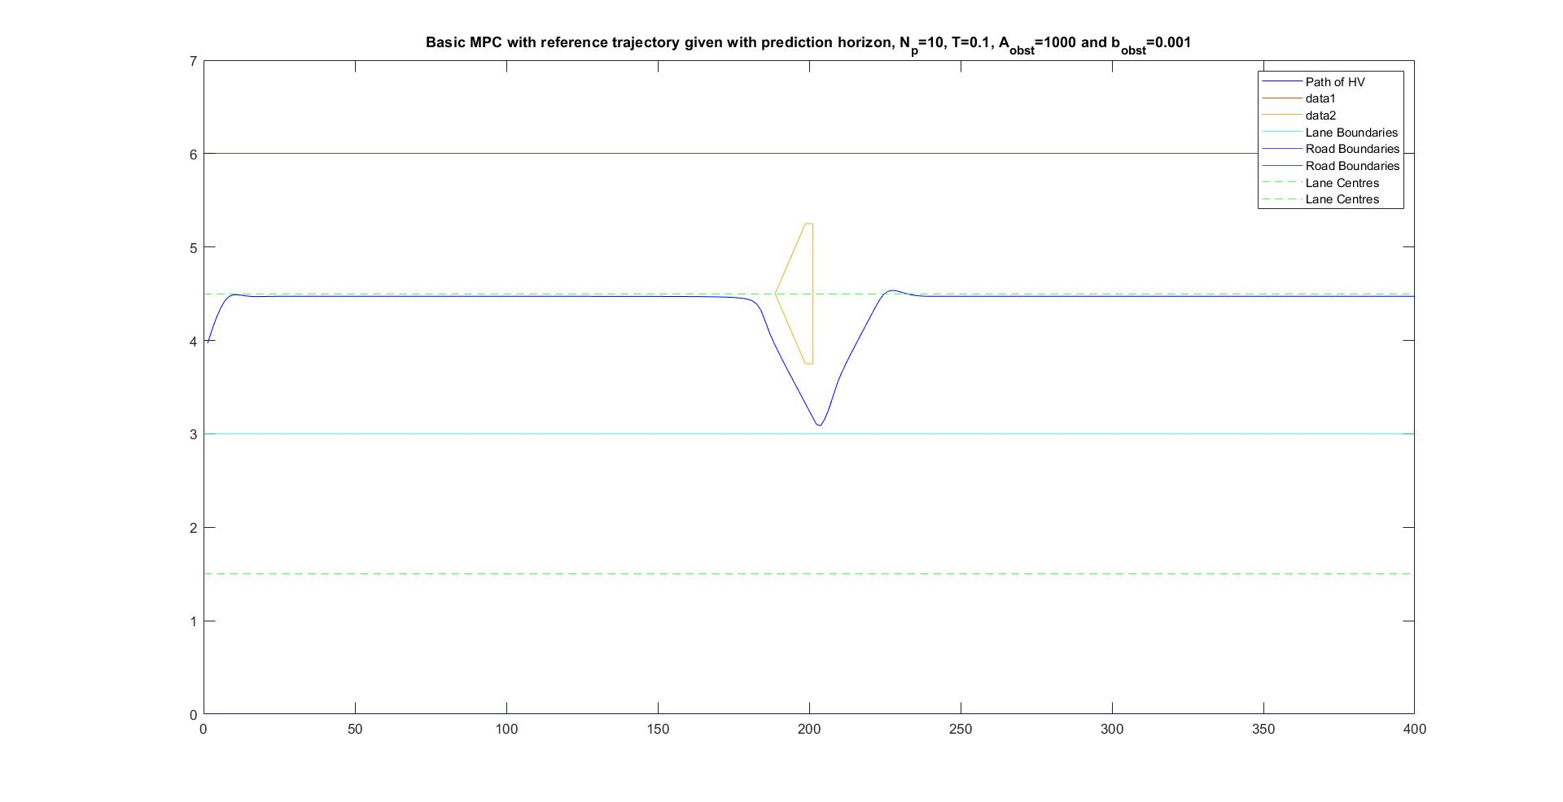
Vehicle Trajectory with Potential 1 as the APF (with distance of the triangular point from the centre of the obstacle = 10m )

Slide 5
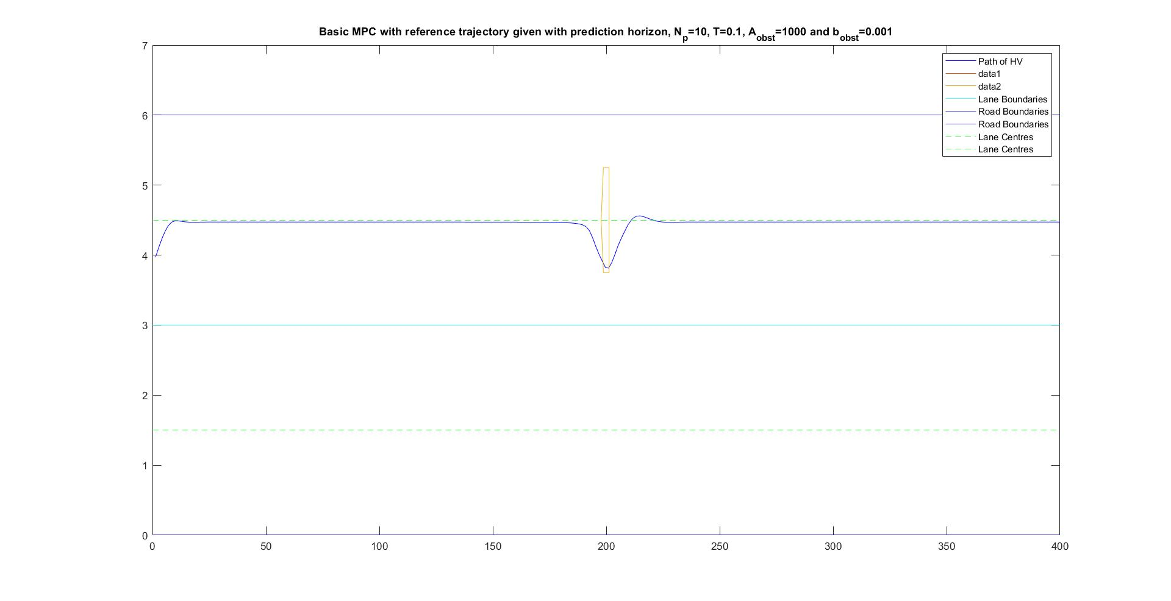
Vehicle Trajectory with Potential 1 as the APF (with distance of the triangular point from the centre of the obstacle = 1m )

Slide 6
Vehicle Trajectory with Potential 2 as the APF (with distance of the triangular point from the centre of the obstacle = 2.5m )

Slide 7
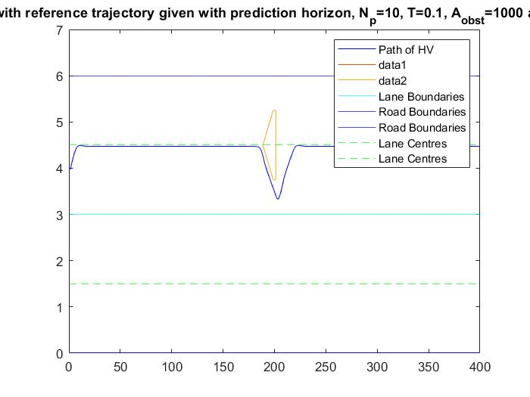
Vehicle Trajectory with Potential 2 as the APF (with distance of the triangular point from the centre of the obstacle = 2.5m )

Slide 8
Problems
Shape of the path taken is very sharp as it crosses the obstacle, and the variables have to be tuned.
The distance from the centre of the obstacle to its triangular tip should be high of the obstacle gets very close to the obstacle.

